Slide 1
Digitalisation and insurance
Tavaziva Madzinga, FANAF 2017

Slide 2
There was a time when the Earth was a very big place...

Slide 3
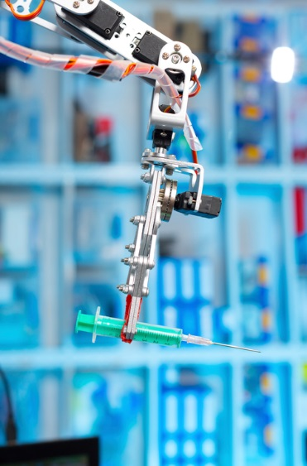
… not any more.
Notes:
Today, I am on the phone to my business colleagues anywhere.
At the moment I’m living in Zurich – 2814 km away.
It would take me about 3 seconds to talk to someone there.
It takes 4 hours to physically be there.
I barely notice the time it akes my PC to dwon load documents I need from there.
Today. My fridge can talk to my car, and my car can talk to a server in Ohio.
This is touching every part of our lives.
A hacker can be using my credit card from 20 000 miles away.
I am working on my PC – which is talking to a server in China.

Slide 4
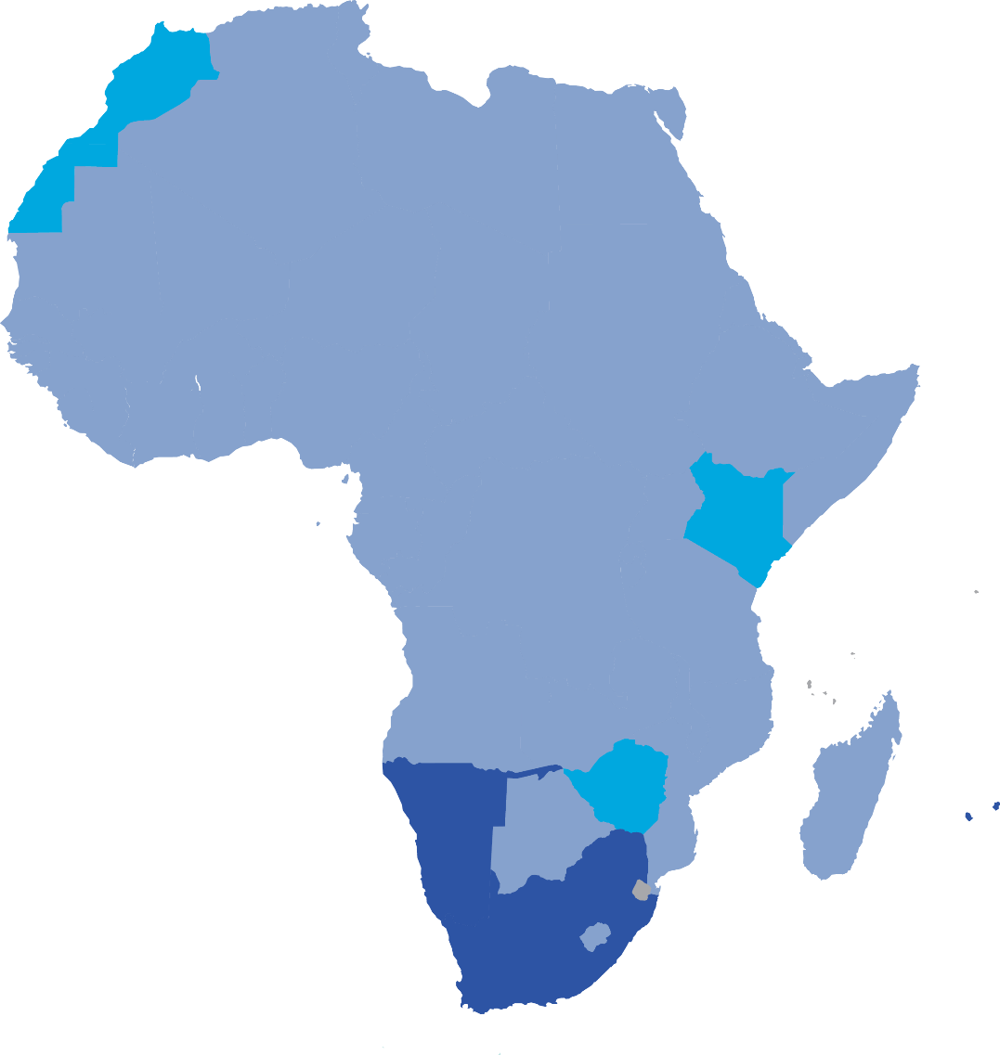
Closing the protection gap across Africa must be our industry’s top priority
Insurance penetration across Africa
Premiums as % of GPD in 2015:
>5%
>3%
Source: Swiss Re Economic Research and Consulting
www.sigma-explorer.com

Slide 5
The spread of mobile technologies is strongest assets to reach people and close the protection gap

Slide 6
Solutions and successes are not future dreams. They are being implemented today across the continent
Notes:
Let’s talk about distance!
We used to say Africa is too remote to reach everyone. …

Slide 7
z
Smart Analytics driving the Digital Transformation of Insurance
Capabilities
Solutions
Quantitative Analytics
Flight Delay Insurance
A flight delay insurance covering short term delays with automatic payout based on a dynamic pricing engine
Contract Intelligence
Automatically analyse over 1 million reinsurance contracts to identify special and critical clauses
Text Analytics
Swiss Re Digital & Smart Analytics Team
Property Risk Screening
Automatically extract all relevant risk attributes from the unstructured reports, increasing productivity by 50%
Cognitive Computing
High Medical Claims
Leveraging predictive modelling techniques on >40 million patients with 1.7 billion drug payment records
Visual
Analytics
Client & Market Intelligence
Quantify and visualize client relationships, hot topics and market trends from over 300’000 discussion notes

Slide 8
Opportunities are everywhere. Where are the risks?

Slide 9
What is the regulatory
perspective?

Slide 10
5
Notes:
Conclusions

Slide 11
Legal notice
©2016 Swiss Re. All rights reserved. You are not permitted to create any modifications or derivative works of this presentation or to use it for commercial or other public purposes without the prior written permission of Swiss Re.
The information and opinions contained in the presentation are provided as at the date of the presentation and are subject to change without notice. Although the information used was taken from reliable sources, Swiss Re does not accept any responsibility for the accuracy or comprehensiveness of the details given. All liability for the accuracy and completeness thereof or for any damage or loss resulting from the use of the information contained in this presentation is expressly excluded. Under no circumstances shall Swiss Re or its Group companies be liable for any financial or consequential loss relating to this presentation.

